Slide 1
Scholarly Hazing
Presented by: Ladies in Tech - Ebonie Gadson, Eugenia Lee and Rakeb Teklehiwot

Slide 2
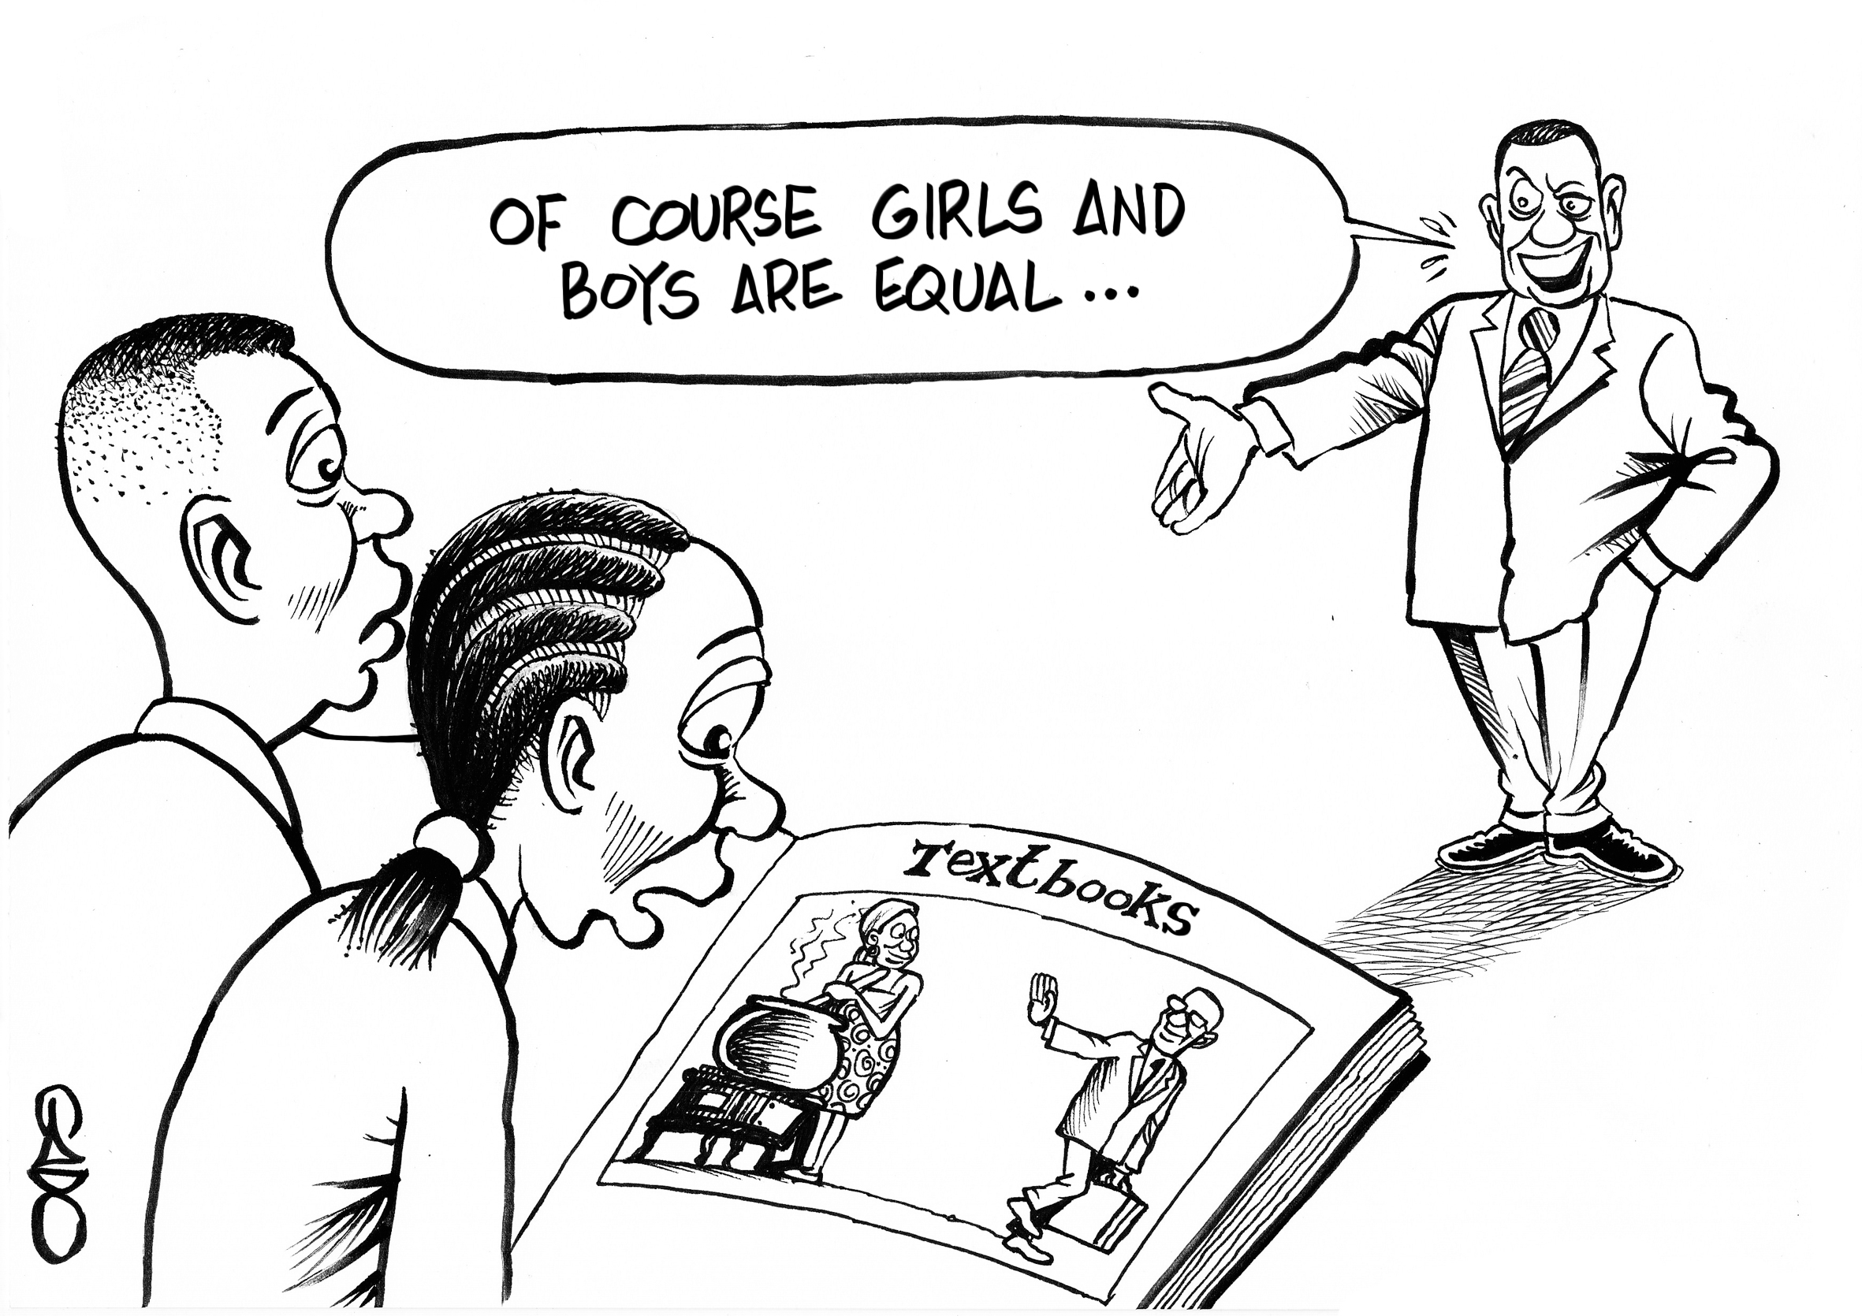
Table of Contents
Project Description/Purpose
Data information
Data Collection
Hypotheses
Methodology
Results
Conclusion

Slide 3

Gender Bias in the Classroom Introduction

Slide 4
Michelle Obama once stated men who dominated the classroom discussions during her undergrad weren’t smarter but “simply emboldened, floating on an ancient tide of superiority, buoyed by the fact that history never told them different.”

Slide 5

Project Description/Purpose
Surveyed 66 students from nine different Maryland institutions
Aimed to bring awareness to the issue of gender inequity in the classroom
Our reason: we experienced gender bias in some of our classes
Are people aware of their bias?

Slide 6
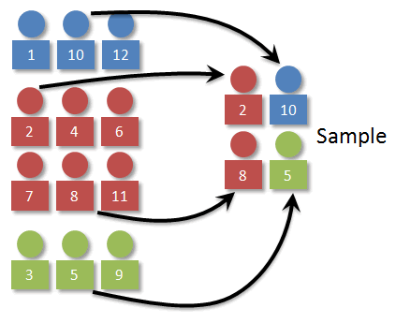
Data Collection
Observational study
Conducted the survey on Google Form
Stratified sampling method: Multiple things in common, one campus, 9 universities

Slide 7
Research Questions
RQ1: Does classmate’s sharing answers based on their gender impact students of a particular major?
RQ2: Are females more perceptive of gender bias than males?
RQ3: Does the existence of gender bias affect a student’s GPA?
RQ4: Do classmates of a particular race/ethnicity interact more with people of the same gender?

Slide 8
Data Information
Variable | Datatype | Label
Major | Categorical | Any majors offered at USG
Home institution | Categorical | BSU, SU, TU, UB, UMB, UMCP, UMBC, UMUC, UMES
Degree Level | Categorical | Undergraduate or Graduate
Race/Ethnicity | Categorical | Asian, Black/African-American, Caucasian, Hispanic/Latin, Native American, Pacific Islander, prefer not to answer, other
Gender | Categorical | Female, Male, or other
Age | Quantitative | Integer
GPA | Quantitative | 0.0 to 4.0
Gender bias existence in USG classrooms | Categorical | Yes, no, other

Slide 9
Methodology
R-studio
Excel
RQ1 - One-sample t test
RQ2 - One-proportion z test
RQ3 - One-sample t test
RQ4 - One-sample t test

Slide 10
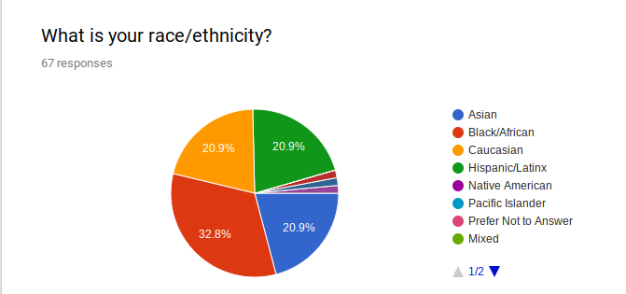

Slide 11
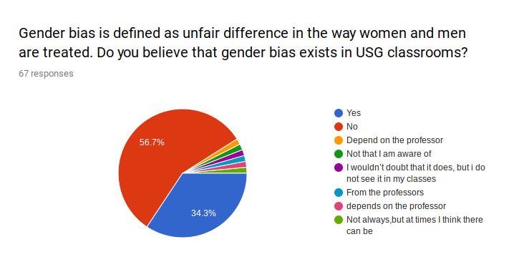

Slide 12
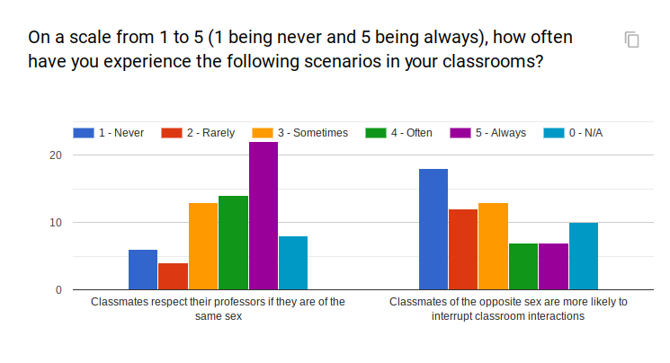

Slide 13
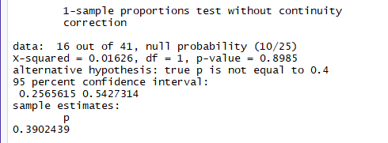
RQ1:
There is a negative correlation between females and whether or not they are aware gender bias exists.

Slide 14
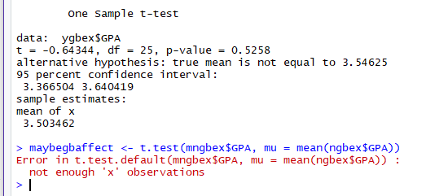
RQ2:
There is a negative correlation between if a student believes that gender bias exists at USG and a student’s GPA

Slide 15
Results
Detecting gender bias at USG was difficult
Overall, we found statistically insignificant for most of our tests (some due to sample size, clarity of question)
Some students mentioned professors were bias
We wanted to make people aware but we were expecting results in our favor

Slide 16
Conclusion
Challenges: small sample size, confused respondents with wording, finding which tests to use
Takeaway: The entire data collection part was really tedious, plan ahead, create a clearer picture for respondents
Interested in collecting more data for subsequent semesters (exploring the topic more)

Slide 17

Have you been discriminating against based on race, gender, sex, religion, creed, age, etc?
Contact Title IX on USG campus:
John Brandt
USG Title IX Liaison, III - 2121
301-738-6021
jbrandt@umd.edu

Slide 18
Thanks!
Any questions ?

